Slide 1
International Prototypes and Experiments (IP&E)
Foreign Comparative Testing (FCT)
Program Overview
Gerard Tighe
Director
International Prototypes & Experiments (IP&E)
February 8, 2024
Colonel Jeffrey Naff, USAF
Director
Foreign Comparative Testing
CLEARED
For Open Publication
Feb 05, 2024
Case 24-T-0861
Department of Defense
OFFICE OF PREPUBLICATION AND SECURITY REVIEW

Slide 2
OUSD (R&E) Organizational Structure
Innovation Steering Group
Defense Agency
Defense Science Board
Under Secretary of Defense (R&E)/CTO
HON Heidi Shyu
Deputy Under Secretary of Defense (R&E)/DCTO
HON David Honey
Office of Strategic Capital
Defense Innovation Board
DIANA Board Chair
Business Operations
Missile Defense Agency
Defense Advanced Research Projects Agency
Systems Engineering and Architecture
Strategic Intelligence and Analysis
Developmental Test, Eval & Assessment
Test Resource
Management Center
Exec Dir, Systems Engineering and Architecture
Deputy CTO for Science & Technology (DCTO(S&T))
Assistant Secretary of Defense for Science and Technology (ASD(S&T))
Assistant Secretary of Defense for Critical Technology (ASD(CT))
Assistant Secretary of Defense for Mission Capabilities (ASD(MC))
KEY
R&E: Research and Engineering
DASD: Deputy Assistant Secretary of Defense
DIANA: Defense Innovation Accelerator for the North Atlantic
DCTO: Deputy Chief Technology Officer
JHTO
A/Steve Wax
Engineering
DASD (Multi-Domain
Joint Operations)
DASD (Prototyping & Experimentation)
DASD (Mission Integration)

Slide 3
Prototyping and Experimentation (P&E)
Deputy Assistant Secretary of Defense (DASD), P&E
Alexander Lovett
Special Operations Programs
Tom Moore
Innovation and Modernization
Jon Lazar
Dir, Operations
CAPT David Doyle
International Prototypes and Experiments
Gerry Tighe
Defense Innovation Acceleration
James Howell
Rapid Prototyping and Experimentation
Dan Ermer
Dir, Assessments
Mike Tran
Dir, Experiments
Willie McCallister

Slide 4
International Prototypes and Experiments (IP&E)
International Prototypes and Experiments (IP&E)
Gerry Tighe - Director
Deputy CTO for Science & Technology (DCTO(S&T))
Foreign Comparative Testing (FCT)
Col. Jeffrey Naff
International Collaboration & Experimentation (ICE)
Mark Morgan
IP&E Operations
Bob Robertson
Desk Officers
Service Representatives
Country
Engagement
Plans and
Programs
Knowledge
Management
Financial
Management

Slide 5
International Prototypes and Experiments (IP&E)
OUSD(R&E) Lead for International Experimentation.
Leads engagement with Partner Nations on experimentation of critical technologies and systems.
Identifies venues and events to conduct International Collaboration and Experimentation.
Provides oversight of the Foreign Comparative Test Program.
Strategic Construct
Cooperative, structured US and Partner-Nation R&D maximizes modernization, increases interoperability, and reduces vulnerabilities.
Allies and Partner Nations are committing R&D resources to modernize their military capabilities in similar priority areas.
Early Collaboration and Experimentation provides an opportunity to identify interoperability improvements before fielding.

Slide 6
Foreign Comparative Testing (FCT)
10 USC 2350a(g) Directs the Secretary of Defense to conduct testing of foreign technology “to satisfy United States military requirements or to correct operational deficiencies.”
  SECDEF delegated the 2350a(g) role to OUSD(R&E).
  International Prototyping and Experimentation (IP&E) provides oversight to the FCT program.
FCT Mission: Find, Assess, & Field World-Class Technologies to Enhance Military Capabilities and Provide Long-Term Value
  Accelerates capability fielding at lower cost and an average of 3 years ahead of organic U.S. RDT&E.
  Strengthens alliances by sourcing world-class solutions to shared defense problems.
Connects Foreign Technologies to U.S. DoD Development and Acquisition Programs
  FCT provides ‘try before you buy’ for partner-nation capabilities, technology, and weapon systems.
  Roughly 1/3 of foreign vendors participating in FCT establish a U.S. presence or partner with U.S. industry.
  Strengthens industrial base and builds resilient supply chains across coalition partners.

Slide 7
International Collaboration and Experimentation (ICE)
Collaboration
  Engage with Partner-Nations and Allied Organizations.
  Act as liaison for all international OUSD R&E Prototyping and Experimenting efforts and events.
  Improve interoperability through Multi-National interactions.
Experimentation
  Manage extended/enhanced testing of FCT Projects.
  Identify non-US based experimentation and exercise events.
  Facilitate military utility evaluation/assessment of technologies in a Coalition/International environment.
  Enable a data-focused Service acquisition decision.
TRAPS lightweight, modular, towed variable depth SONAR (CAN)
Demonstrated at NATO REPMUS 22 EXERCISE
October 2022

Slide 8

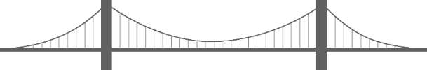





FCT Project Ecosystem
VALLEY 1
from Lab to Prototype
VALLEY 2
from Prototype to Product
VALLEY 3
from Product to Scale
1
1
2
3
2
3
Lab
Prototype
Product
Scale
R&D Progression
Low-Rate Initial Production (LRIP)
Full-Rate Production (FRP)
TRL:
1 | 2 | 3 | 4 | 5
6 | 7
8 | 9
MRL:
1 | 2 | 3 | 4
5 | 6
7 | 8
9 | 10
Foreign Comparative Testing (FCT)
Transition Paths
Additional R&D/Test
Inform Requirements
Modernize Standards
System Acquisition

Slide 9



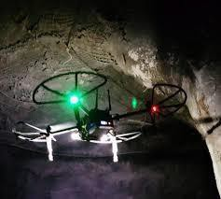


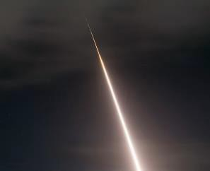


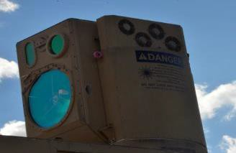

OUSD(R&E) Critical Technologies
Trusted Artificial Intelligence & Autonomy
Biotechnology
Quantum Science
Integrated Network Systems-of-Systems
Integrated Sensing & Cyber
Microelectronics
Human Machine Interfaces
Hypersonics
Future Generations Wireless Networks (Future-G)
Space Technology
Advanced Computing & Software
Directed Energy
Advanced Materials
Renewable Energy Generation & Storage
www.cto.mil/usdre-strat-vision-critical-tech-areas/
FCT Project Alignment:
  FCT Projects are not limited to inclusion within OUSD(R&E) Critical Technology List
  Projects are aligned to Service Needs/Requirements

Slide 10
FCT Acquisition Authorities
Foreign Comparative Testing Program Acquisition Authorities (Title 10 USC 2350a(g))
System/Technology Test | Assessment | Acquisition/Implementation
Test/Assessment Specific Contract Capability Direct Engagement with Industry/Corporations Non-Competition/Sole-Source Award No International/Project Arrangements (IA/PA) required Quantities Limited to Testing Need No Defined Contract Duration |  | Acquisition Focused Contract Direct Engagement with Industry/Corporations Non-Competition/Sole-Source Award No International/Project Arrangements (IA/PA) required Low-Rate Production Quantities (LRIP) Five-Year Post-Decision Procurement
FCT Led |  | Service/CCMD Led
Acquisition Decision
FCT participation is open to industry in ALL US State Department approved Partner Nations

Slide 11
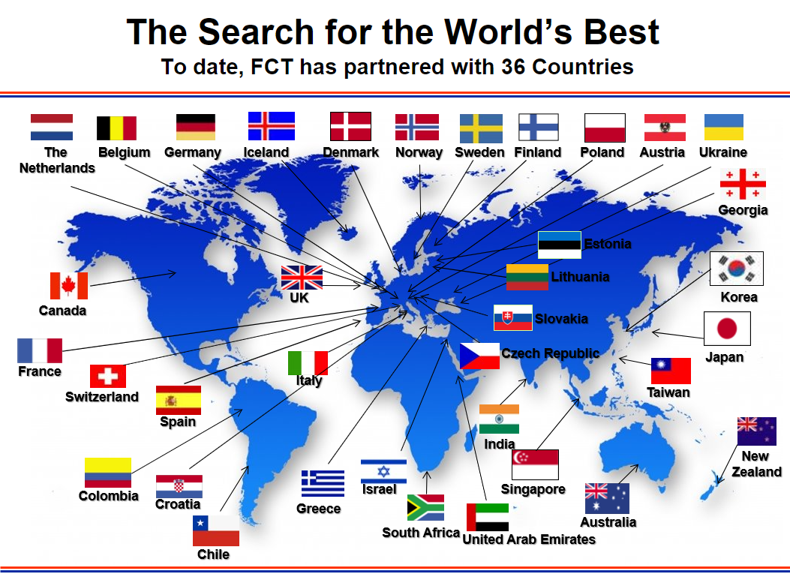






FCT Customer Base
875
Projects
1297
Technologies Assessed
307
Technologies Transitioned
OUSD investment: $1.589 Billion
  Procurement of 307 projects worth over $11B
  Average project – $500-700K/year; 18-24 months
As of Jan 2024
Notes:
399 completed successfully (met testing requirements)
Of 399 successful projects, 306 procured/acquired
Remaining 93 either did not transition or were partially successful (test article in use, follow-on RDT&E, inform requirements, etc.)

Slide 12
FCT Project Proposal Process
Project Initiation/Evolution
Initial Proposal
Final Proposal
Project Selection
Technology Discovery
Project Definition
Proposals are submitted to OUSD by the Services/CCMDs
OUSD
Capability Identification
Market Research
Technology Scouting
Industry Engagement
Service Socialization
Requirement Delineation
Program-of-Record Applicability
Logistics/Life-Cycle Impact
Priority Assessment
Proposal Development
Scope Definition
Transition Track Alignment
Project Plan Development
Secure Funding
Proposal Submission
Project Selection Criteria
OUSD (Top Down)
Joint Warfighting Concepts
Technology Transition Path
Joint Application
Service Cost Share/Cost Avoidance
OUSD Priorities (Focus Areas)
Services (Bottom-Up)
Mission Need
Sponsor Support/Endorsement
Risk (Cost/Schedule/Performance)
Procurement Strategy
Services
Process can be expedited to respond to Operational Needs

Slide 13
FCT Project Execution
Phase I
Funding Allocation/
Contract Initiation
Procurement/
Delivery
System Integration
Test Execution/
Data Collection
Test Planning
Phase II
Data Reduction/ Initial Assessment
Final Report/
Documentation Preparation
FCT Project Close-out
Service Acquisition Decision
Extended/Enhanced Testing
FCT Project Execution is Managed by the Services with OUSD Oversight

Slide 14
FCT Testing and Extended/Enhanced Testing
Testing:
  Evaluate a FCT Project’s potential to meet capability gaps, enhance lethality, and increase readiness.
  Defined in FCT Project scope.
Extended/Enhanced Testing:
  Extended: Additional testing above/beyond FCT Project’s scope.
  Enhanced: Execution of planned FCT Project testing in relative operation environment (e.g. exercise/experimentation event).
  Increase probability of technology/capability transition through National and International exposure.
Locations:
  US Based Test Capabilities/US Ranges
  On-Site Testing/Host Nation Testing and Ranges
  World-wide experimentation and exercise events
Extended/Enhanced Testing Examples:
  Asymmetric Force Engagement – Fire/Forget solution for Fast Inshore Attack Craft (FIAC)
    Test: Korean Poniard Rocket fired from terrestrial vehicle in ROK test event.
    Extended Testing: Additional test shots Unmanned Surface Vessel (USV) at ROK test event and Key West event (U.S. Navy); planned live-fire demonstrations at Integrated Battle Problem 24-1 and RIMPAC 2024.
  Anti Submarine Warfare (ASW) on Unmanned Surface Vehicle (USV)
    Enhanced Testing: REPMUS (Robotic Experimentation and Prototyping using Maritime Uncrewed Systems), October 2022 (Annual Portuguese/NATO Exercise).
  US Military Service Rep/Test Authorities present

Slide 15
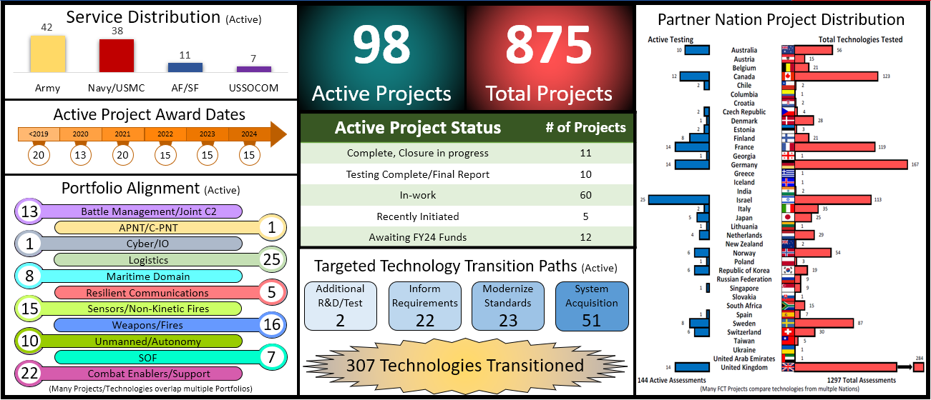
FCT Program Statistics
Colombia
As of Jan 2024

Slide 16













Technology Discovery
OUSD(R&E) Sponsored Events
Government to Business Meetings
Embassy Activities/Events
International Travel/Site Visitation
Trade Shows
Commerce-Based Organizations
Service-Focused Events
Industry Days
Attachés

Slide 17
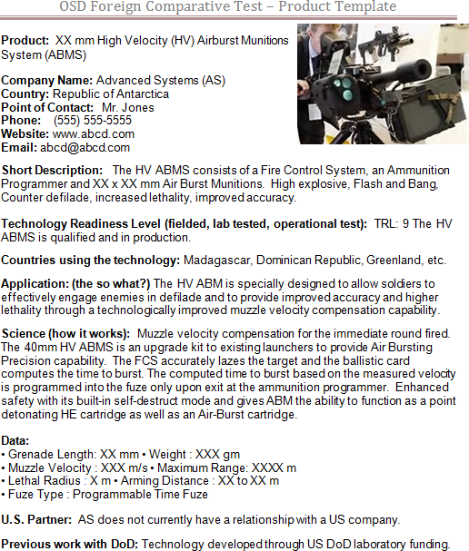
Send Us Your Product Information
Product Template
Product
Company Name
Country
POC Information
Website
Technology Readiness Level
Countries Using
Application (So What?)
Science (How It Works)
Data (Key Performance Metrics)
US Partners
Previous Work w/ DoD
Help us understand how your technology is Better, Affordable or Novel!

Slide 18
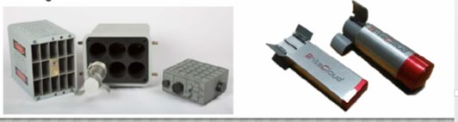
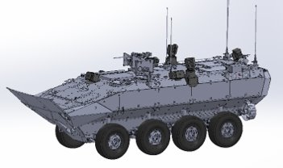
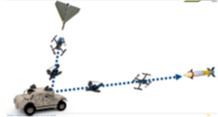
Countermeasure Projects
Successful | Completing | In-Progress
AN/ALQ-260V(1) (BriteCloud)
Active Protections System/Hard Kill
DUAL ATGM and UAS Defeat
Active RF Countermeasures for 4th Generation Fighters –
Active Countermeasures for light armored vehicles
Active/Autonomous Countermeasures for light vehicles
Wide Band Digital Countermeasure – Active expendable decoy with RF countermeasures against missile threats
Service Partner: USAF/ANG
Industry Partner: Leonardo, UK Deployed supporting operations in Ukraine.
Joint Warfighting Concept Alignment:
Expanded Maneuver
APS/HK – Autonomous integrated sensor, tracking, and engagement, with hard kill against threats to LAV’s.
Service Partner: USMC
Industry Partner: Elbit, IMI, Israel. Deployed in support of IDF Operations in GAZA
Joint Warfighting Concept Alignment:
Expanded Maneuver
Standoff autonomous fast drone interceptor, designed to counter Anti-Tank Guided Missiles and UAS threats.
Service Partner: US Army
Industry Partner: Elbit, Israel
Joint Warfighting Concept Alignment:
Expanded Maneuver

Slide 19
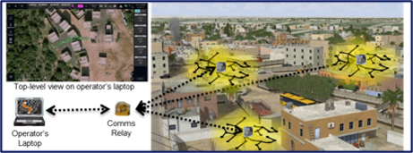

Sensor Projects
Successful | Completing | In-Progress
Sappheiros-3D
USV ASW for Expanded Maneuver
Video Detection And Ranging (ViDAR)
Persistent ground and Underground Surveillance
Wide Angle – Wide Field of View Sensor for Small UAS
Man-portable, rapidly deployable, unattended multi-modal sensing system for simultaneous perimeter and sub-terranean surveillance. Demonstrated at TREX 23-1 May 2023.
Service Partner: US Army
Industry Partner: Elbit, Israel. Currently deployed supporting IDF operations in Gaza.
Joint Warfighting Concept Alignment:
Expanded Maneuver
TRAPS lightweight, modular, towed variable depth SONAR. Demonstrated at NATO REPMUS 22 EXERCISE (October 2022).
Service Partner: US Navy
Industry Partner: Geo-spectrum, Canada
Joint Warfighting Concept Alignment:
Joint Fires
Expanded Maneuver
Multi-Camera wide angle/wide field of view sensor for small UAS. Providing 300 times converge area in littoral Battlespace
Service Partner: US Navy
Industry Partner: Sentient, Australia
Joint Warfighting Concept Alignment:
Command and Control,
Expanded Maneuver

Slide 20
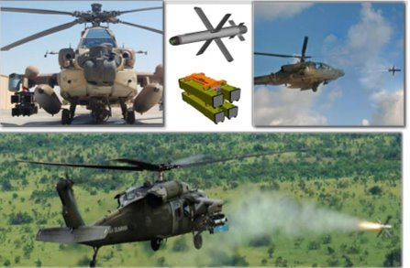
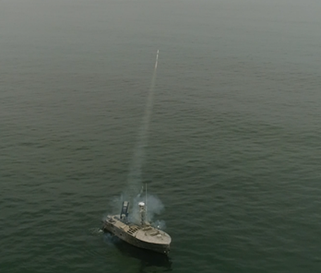
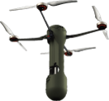
Kinetic Projects
Successful | Completing | In-Progress
Aviation Long Range Precision Fires
Asymmetric Force Engagement
Standoff missile to engage threat air defense systems
Fire and forget solution for Fast Inshore attack craft (FIAC)
Air Launched UAS for Kinetic Engagement
Off-Board Sensing and Strike for simultaneous engagement of multiple targets
EO/IR guided NON line of Sight missile capable of engaging threat air defense systems from helicopters. US ARMY procuring missile beginning in FY24.
Service Partner: USA
Industry Partner: Rafael, Israel
Joint Warfighting Concept Alignment:
Joint Fires
Expanded Maneuver
IR guided 2.75 in rocket capable of countering swarm tactics of fast attack craft. Proven engagement off a USV in Oct 2023 – 6 launches with 6 kills
Service Partner: USN
Industry Partner: LIG Nex1, Republic of Korea
Joint Warfighting Concept Alignment:
Expanded Maneuver
Common Launch Tube - small UAS with sensing and kinetic strike munitions capability, deployable from aircraft or Large UAVs
Service Partner: USAF
Industry Partner: Defendtex, Australia
Joint Warfighting Concept Alignment:
Joint Fires
Expanded Maneuver

Slide 21
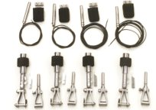
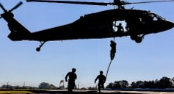
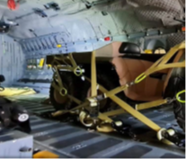
Combat Support Projects
Successful | Completing | In-Progress
Water/Land Sensing Aerial Disconnect
Fast Rope
Insertion/Extraction System
Flexible Bridle Restraint System
Enables autonomous deployment of air dropped UUV/USVs
Fast Insertion of Tactical Response Elements
Enables deployment of air dropped nonstandard vehicles and cargo
Fast Rope insertions are critical to Special Forces/MARSOC/JSOC response capabilities in maritime, urban, and rough terrain operations. Current US supply limited to a single vendor.
Service Partners: USSOCOM/USA/USMC
Industry Partners: UK, Spain, and Canada
Joint Warfighting Concept Alignment:
Expanded Maneuver
Water and Land sensing-initiated aerial disconnect systems automatically release parachute suspension slings on water or ground impact. Enabling automatic deployment of manned or unmanned combat craft and systems.
Service Partner: USA/USSOCOM/USMC
Industry Partner: IrvinGQ, UK
Joint Warfighting Concept Alignment:
Expanded Maneuver
Flexible restraint system for nonstandard cargo and vehicles. 5-10X faster install and breakdown compared to current DOD process. When combined with automatic release creates capability to air drop autonomous vehicles.
Service Partners: USSOCOM/USA/USMC
Industry Partner: Fiber Tech, Australia
Joint Warfighting Concept Alignment:
Expanded Maneuver

Slide 22
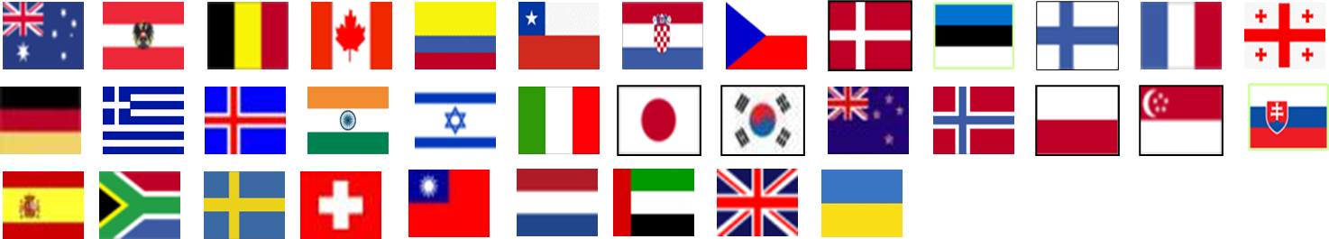
How to Get More Info
Contact the Security Cooperation Office / Attachés in the U.S. Embassy in your country
Contact your Embassy in Washington, D.C. – Defense Attaché or the Trade / Science & Technology organization
Contact FCT Program directly – either the main office or Service/SOCOM specific contacts listed in this brief
Strengthening Partnerships - Delivering Operational Capability

Slide 23
Key Points of Contact
OSD | FCT Office |  | 571-372-6803
 | Gerry Tighe | gerard.p.tighe.civ@mail.mil | 703-697-3984
 | Col. Jeffrey Naff | jeffrey.e.naff.mil@mail.mil | 703-693-5647
 | Sean Hilber | sean.a.hilber.ctr@mail.mil | 571-372-6822
 | Manuel “Manny” Almanza | manuel.almanza.ctr@mail.mil | 703-693-5647
 | Darius Watts | darius.y.watts.ctr@mail.mil | 571-372-6405
 | International Collaboration & Experimentation
 | Mark Morgan | mark.j.morgan26.ctr@mail.mil | 571-372-6822
Army | Mark C. Hassler II | mark.c.hassler.civ@army.mil | 410-322-1457
 | Rino Imperiale | rino.imperiale.civ@army.mil | 410-306-4828
Navy/USMC | Mark Stoffel | mark.stoffel.ctr@us.navy.mil | 571-227-6905
 | Lilia Ramirez | lilia.l.ramirez.ctr@us.navy.mil | 703-405-1311
 | Steve Duong | Steve.duong@usmc.mil | 703-432-8782
 | Jackie Brent | Jacqueline.brent@usmc.mil | 703-432-8780
Air/Space Force | William “Bill” Reed | william.reed.11.ctr@us.af.mil | 571-215-8926
SOCOM | Gail Kemeliotis | gail.m.kemeliotis.ctr@socom.mil | 813-826-0192
Note: U.S. prefix is +1

Slide 24

Questions
Gerard Tighe
Director, International Prototypes and Experiments
gerard.p.tighe.civ@mail.mil
Colonel Jeffrey Naff, USAF
Director, Foreign Comparative Testing
jeffrey.e.naff.mil@mail.mil

Slide 25
10 USC 2350a – Cooperative R&D Agreements
(g) Side-by-Side Testing.-
  (1) It is the sense of Congress-
    (A) that the Secretary of Defense should test covered equipment, munitions, and technologies to determine the ability of such covered equipment, munitions, and technologies to satisfy United States military requirements or to correct operational deficiencies; and
    (B) that while the testing of non-developmental items and items in the late state of the development process are preferred, the testing of such covered equipment, munitions, and technologies may be conducted to determine procurement alternatives.
  (2) The Secretary of Defense may acquire covered equipment, munitions, and technologies for the purpose of conducting the testing described in that paragraph.
  (3) The use of side-by-side testing under this subsection may be considered to be the use of competitive procedures for purposes of chapter 137 ¹ of this title, when procuring items within 5 years after an initial determination that the items have been successfully tested and found to satisfy United States military requirements or to correct operational deficiencies.
(a)(2) The countries and organizations with which the Secretary may enter into a memorandum of agreement (or other formal agreement) under paragraph (1) are as follows:
  (A) The North Atlantic Treaty Organization.
  (B) A NATO organization.
  (C) A member nation of the North Atlantic Treaty Organization.
  (D) A major non-NATO ally.
  (E) Any other friendly foreign country.
  (F) The European Union, including the European Defence Agency, the European Commission, and the Council of the European Union, and their suborganizations.

Slide 26
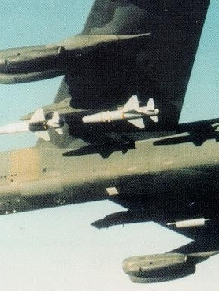
FCT Big Wins: 1980s
AGM-142 HAVE NAP Stand-Off Weapon System
Description: Designated by the U.S. Air Force as the AGM-142, this solid rocket powered precision guided stand-off missile was launched from F-4, F-111, and B-52 aircraft enabling attack of high value land targets at sufficient range to provide protection from enemy air defenses. The missile represented the first precision guided munition to be carried by the B-52H.
Country of Origin: Israel (Rafael)
Outcome: USAF initiated procurement of over 150 AGM-142 missiles starting in 1989.

Slide 27
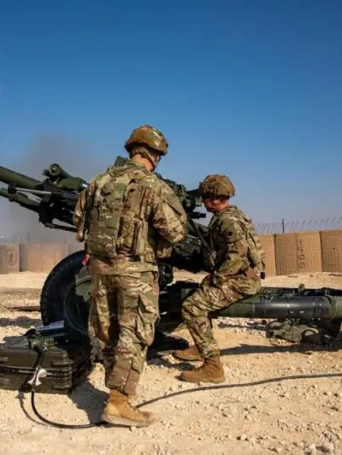
FCT Big Wins: 1980s
M119 105MM Towed Howitzer
Description: The M119 is a lightweight towed howitzer in service with the US Army providing direct and indirect fire support. It can fire all standard NATO 105MM ammunition. The M119 is primarily towed by the high-mobility multipurpose wheeled vehicle (HMMWV) and can be routinely airdropped by parachute and carried underslung by the CH-47 Chinook or UH-60 Black Hawk helicopters.
Country of Origin: United Kingdom (Royal Ordnance)
Outcome: In 1987 an agreement was reached to produce the L119 under license by the US as the M119, to replace the M102 howitzer. It entered service with the 7th Infantry Division, Fort Ord, California, in December 1989. The M119 has been produced in the USA by Watervliet Arsenal, New York (tubes) and Rock Island Arsenal, Illinois (carriages).

Slide 28
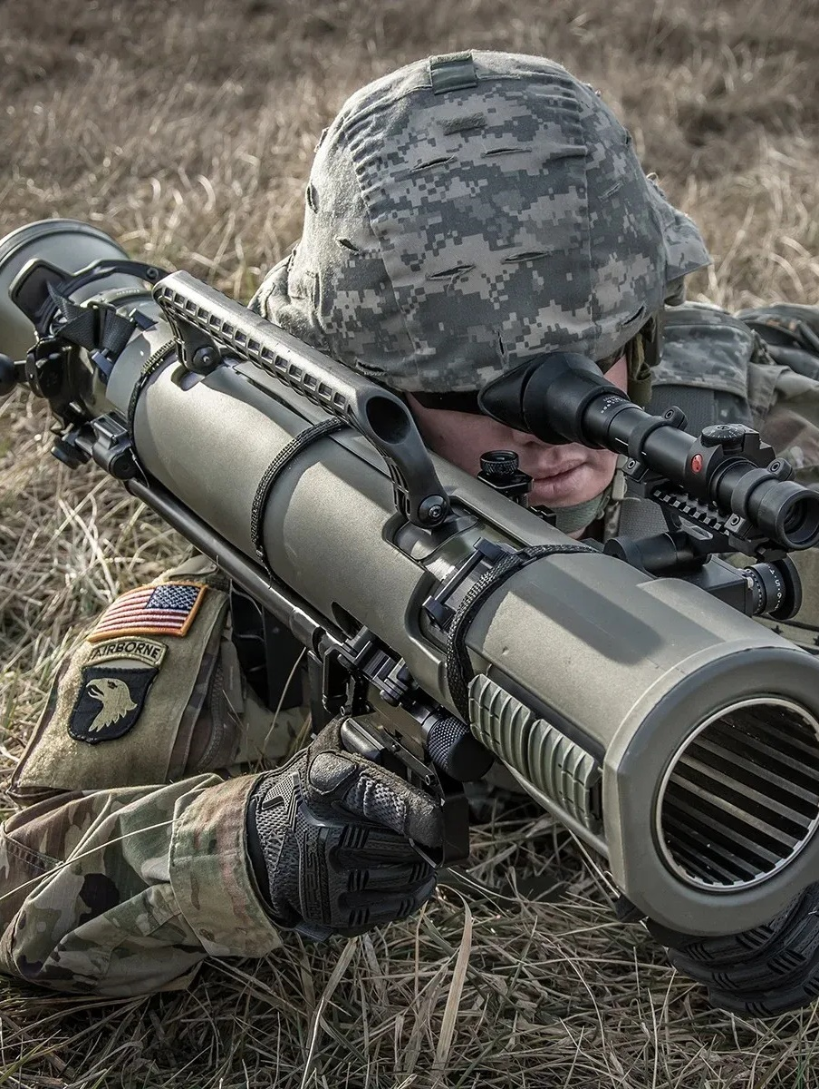
FCT Big Wins: 1990s
Ranger Anti-armor Anti-personnel Weapon System (Carl Gustav)
Description: Man-portable 84MM shoulder-fired reusable recoilless rifle for close-range tank and infantry targets. The Carl Gustav is a lightweight, low-cost weapon that uses a wide range of ammunition, making it extremely flexible and suitable for a wide variety of roles
Country of Origin: Sweden (Saab Bofors)
Outcome: Initially adopted by Special Forces in the 1990s, upgraded M3 variant was designated as a Program of Record within the U.S. Army and became standard-issue in Army Light Infantry units in 2014. DoD procurement of Carl Gustavs is in the thousands the weapon system has been used operationally in several conflicts throughout its history including in Ukraine.

Slide 29
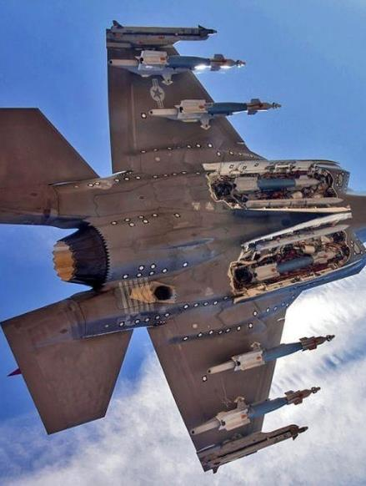
FCT Big Wins: 1990s
High Pressure Pure Air Generator (HiPPAG)
Description: Integrated pure air compressor and filtration system which was​ designed to replace rechargeable gas bottles on aircraft for​ cryogenic missile seeker cooling to reduce maintenance and logistics costs by removing requirement for cryogenic cooling bottles.
Country of Origin: United Kingdom (Ultra Electronics)
Outcome: Over 3000 HiPPAG systems delivered to US Navy since 1997 for Sidewinder AIM-9 L/M missiles on US Navy and Foreign Military Sales aircraft including: AV-8B, F/A-18 C/D, F/A- 18 E/F,AH-1 and F-35. Successful FCT tests led to other DoD Programs leveraging​ HiPPAG, replacing explosive cartridges for weapons ejection systems with improved safety and lower cost. Total procurement in the $Bs.

Slide 30
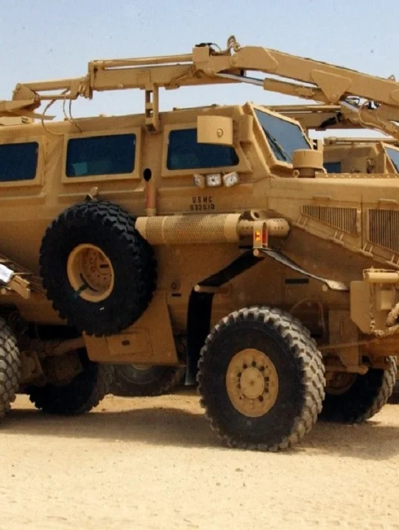
FCT Big Wins: 2000s
Mine Protected Clearance Vehicle (Buffalo MRAP)
Description: A blast-resistant vehicle designed to protect soldiers from the effects of landmine explosions during route clearance operation.
Country of Origin: South Africa (Denel Mechem)
Outcome: Vehicle design with “V-shape hull” licensed to Force Protection Industries in South Carolina for production to support DoD procurements. Over 40 systems procured and fielded. Used extensively in Operation Iraqi Freedom and Operation Enduring Freedom.

Slide 31
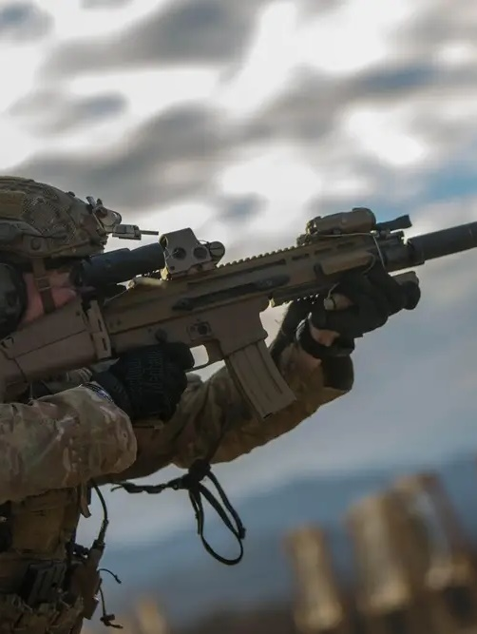
FCT Big Wins: 2000s
SOF Combat Assault Rifle (SCAR)
Description: A family of modular, gas-operated, short-stroke automatic rifles designed to meet special forces requirements. Consists of two versions: SCAR-Light (5.56×45mm ) and SCAR-Heavy (7.62×51mm) .
Country of Origin: Netherlands (FN Herstal)
Outcome: The selection of the SCAR in 2004 was the first assault rifle procured by the United States military through a full and open competition since the M4/M16 trials were held in the mid-1960s.

Slide 32
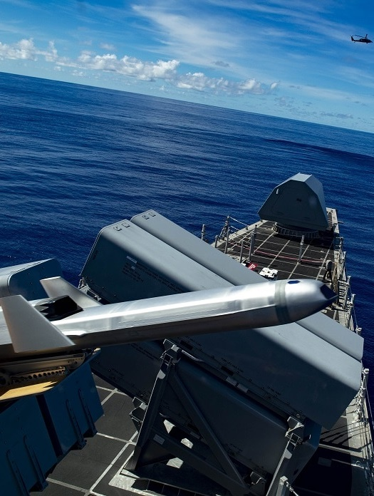
FCT Big Wins: 2010s
Naval Strike Missile (NSM)
Description: Highly survivable, anti-surface missile with a range of 100+ nm​ boasting a state-of-the-art design with low observable features​,imaging infrared seeker and onboard database capable of​ independent target detection, recognition, and discrimination​.
Country of Origin: Norway (Kongsberg)
Outcome: Selected to fill a capability gap for the Navy’s Over-the-Horizon Weapon System for the Littoral Combat Ship. U.S. Navy awarded a contract to Raytheon in June 2018 for procurement of NSM worth up to $847M

Slide 33
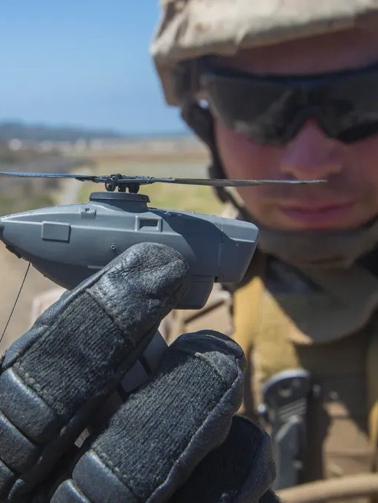
FCT Big Wins: 2010s
Soldier Borne Sensor
(Black Hornet Micro UAS)
Description: Soldier carried unmanned aerial vehicles that enable actionable situational awareness at the tactical edge. The Black Hornet III provides a flight time of up to 25 minutes, is quiet, extremely light, and well suited for operations in contested environments.
Country of Origin: Norway (Prox Dynamics)
Outcome: U.S. Army began acquiring the Black Hornet III from Teledyne FLIR (formerly Prox Dynamics) of Norway. To date, the Army has procured over $115M worth of Black Hornet III systems.

Slide 34
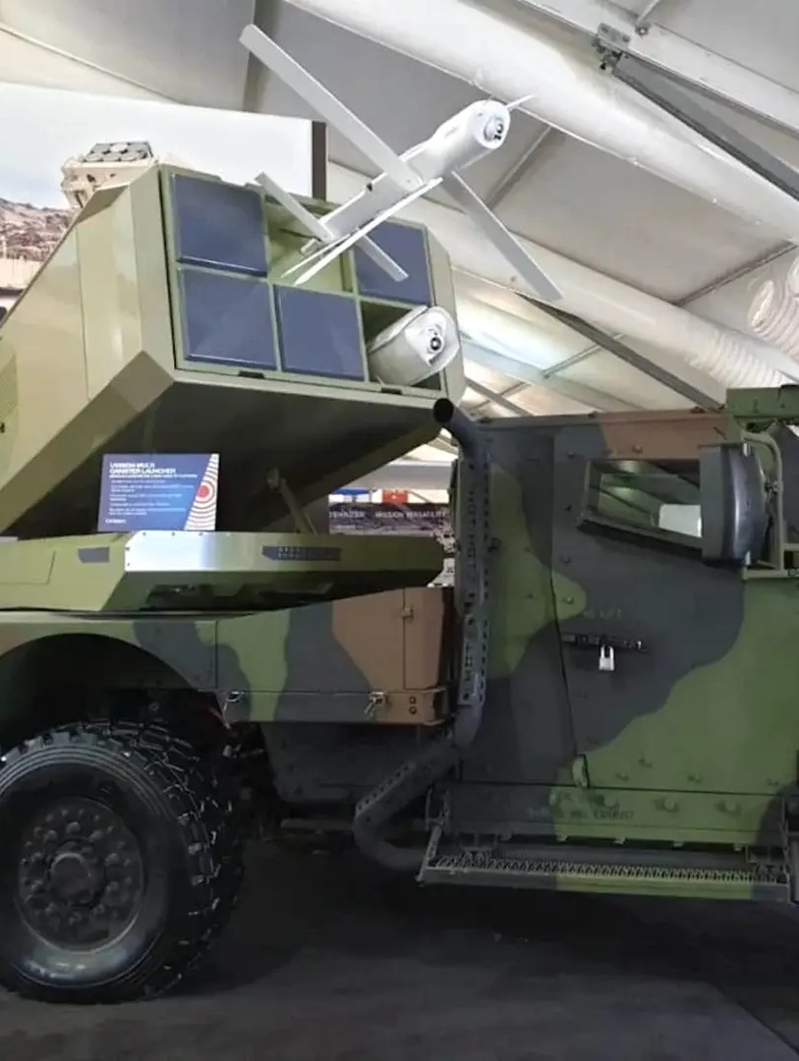
FCT Big Wins: 2020s
Precision Strike System
(Hero-120 Loitering UAS)
Description: Medium range anti-armor loitering munition enabling forces to operate independently without having to rely on fire support or intelligence gathering from other units or higher echelons.
Country of Origin: Israel (UVision)
Outcome: In 2021, the USMC awarded a multi-year contract to UVision for procurement of the Hero-120 to support the Organic Precision Fires-Mobile (OPF-M) program of record.

Slide 35
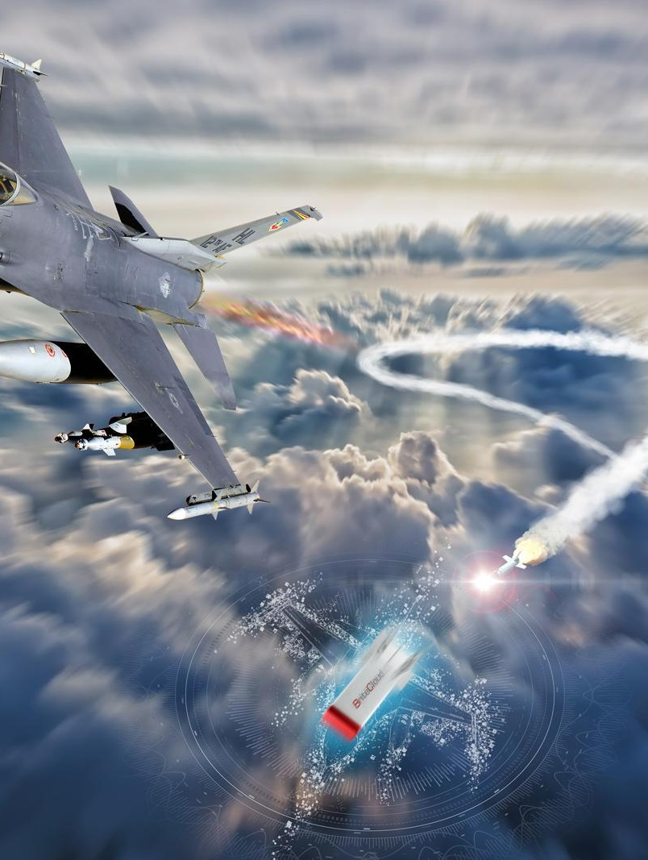
FCT Big Wins: 2020s
Britecloud Active Expendable Decoy
Description: A first of its kind small active self-contained Digital RF Memory (DRFM) countermeasure for non-stealthy aircraft to defeat modern and legacy Surface-to-Air and Air-to-Air threat systems. BriteCloud is dispensed from standard chaff and flare dispensers and requires minimal platform integration.
Country of Origin: United Kingdom (Leonardo)
Outcome: In November 2022, the U.S. Air Force designated Britecloud as AN/ALQ-260(V)1, identifying it as an airborne electronic warfare countermeasure and the Air National Guard issued a fielding recommendation for F-16s.

Slide 36
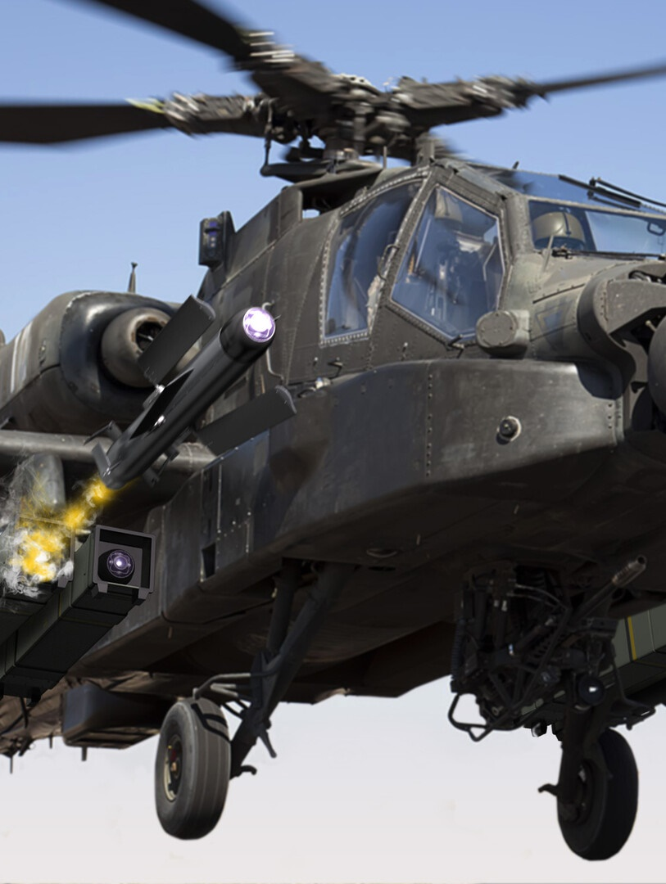
FCT Big Wins: 2020s
Spike Non-Line-of-Sight (NLOS) Missile
Description: Radio Frequency-guided, NLOS missile with electro-optical, imaging infrared seeker and man-in-the-loop control, capable of hitting targets at long ranges (over 30km), allowing safe engagement beyond the range of most modern air defense systems.
Country of Origin: Israel (Rafael)
Outcome: Lockheed Martin awarded a contract in 2023 to field Spike NLOS on the AH-64E V6 as the interim solution for the Army’s Long Range Precision Munition. LM also integrating Spike NLOS onto Joint Light Tactical Vehicles for the USMC and USSOCOM ground vehicles.

Slide 37
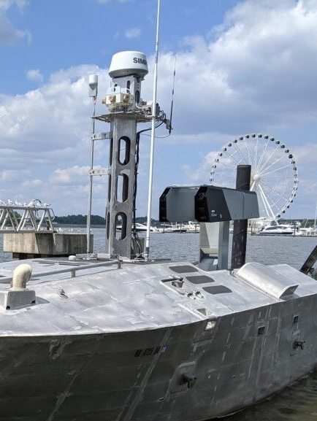
FCT Big Wins: 2020s
Fast Inshore Attack Craft (FIAC) Asymmetric Force Application
Description: A “fire and forget” 2.75 inch rocket with an advanced Imaging Infrared seeker integrated on an Unmanned Surface Vehicle (USV). This technology provides an effective asymmetric defense capability against FIAC swarms.
Country of Origin: Republic of Korea (LIGNex1)
Outcome: Successfully demonstrated during 4th Fleet Exercise in Key West, FL in October 2023.

